Slide 1
On VR Spatial Query for Dual Entangled Worlds
Shao-Heng Ko
Academia Sinica, Taiwan
with Ying-Chun Lin, Hsu-Chao Lai, De-Nian Yang, Wang-Chien Lee

Slide 2

Immersive VR

Slide 3
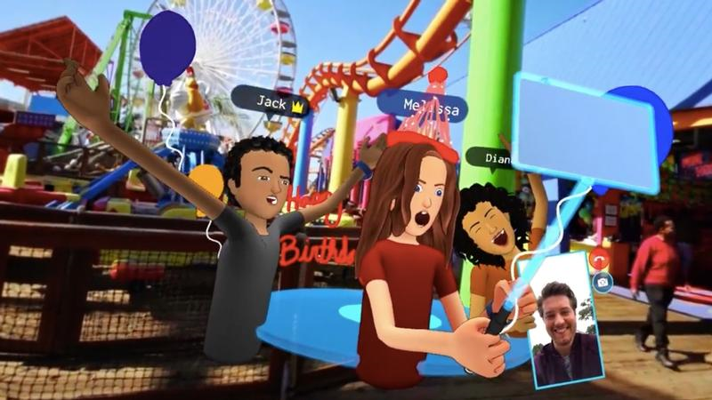
Moving in Virtual Reality
Moving/locomotion is an essential operation in
VR social platforms
Facebook Spaces
https://www.techadvisor.co.uk/feature/social-networks/what-is-facebook-spaces-3658718/

Slide 4

Moving in Virtual Reality
Moving/locomotion is an essential operation in
VR social platforms
VR shopping
Alibaba Buy+
https://www.trendhunter.com/trends/alibaba-buy

Slide 5

Moving in Virtual Reality
Moving/locomotion is an essential operation in
VR social platforms
VR shopping
VR tourism
VR tourism.
http://www.virtual-reality-in-tourism.com/

Slide 6

Moving in Virtual Reality
Moving/locomotion is an essential operation in
VR social platforms
VR shopping
VR tourism
VR gaming
Rec Room (A popular VR online social game)
https://store.steampowered.com/app/471710/Rec_Room/

Slide 7
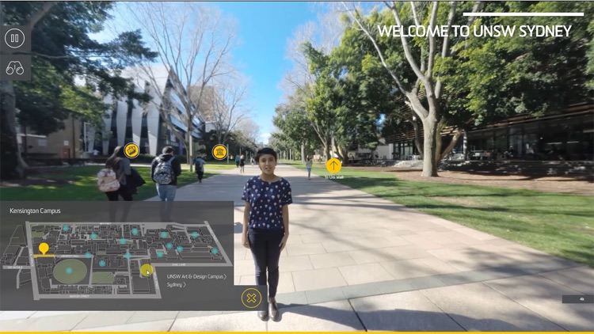
Moving in Virtual Reality
Moving/locomotion is an essential operation in
VR social platforms
VR shopping
VR tourism
VR navigation
UNSW 360 Campus Tour
Goal:
Moving between point-of-interests
IMMERSIVELY.
https://appadvice.com/app/unsw-360-vr-campus-tour/1310207442

Slide 8
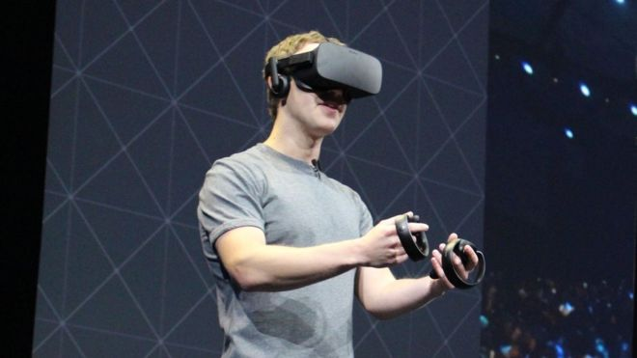

Moving in Virtual Reality
Next-generation VR devices are wireless or standalone, enabling users to walk freely in physical world
Mark Zuckerberg with a wireless HMD
Oculus Quest

Slide 9
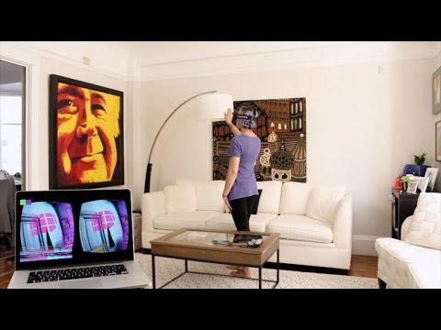
Challenges
Users are constrained by the small-sized, obstructed physical space (e.g. living room) when exploring massive virtual environments
Different physical spaces for different users
Combination of two worlds not known in advance
http://www.youtube.com/watch?v=qbkwew3bfWU

Slide 10
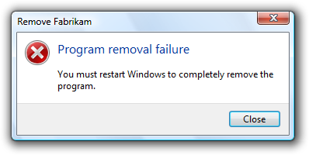
Spatial Data Management
Traditional research on spatial data are rich:
k-nearest-neighbors (kNN)
range queries
trajectory mining
spatial queries on graph networks…
Spatial Query in VR
Spatial Query Failure
The issued query is designed for ONE world only.

Slide 11
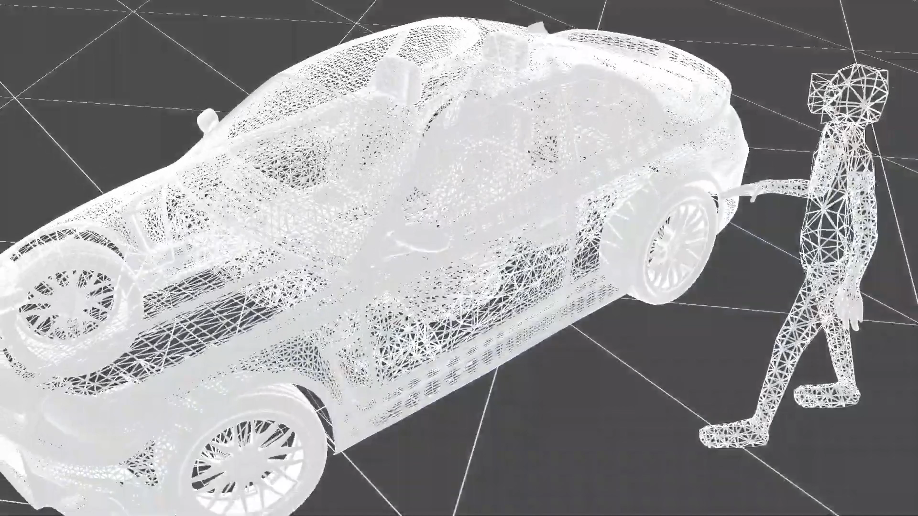
Current VR locomotion
https://youtu.be/kPFhmWQwXMI

Slide 12
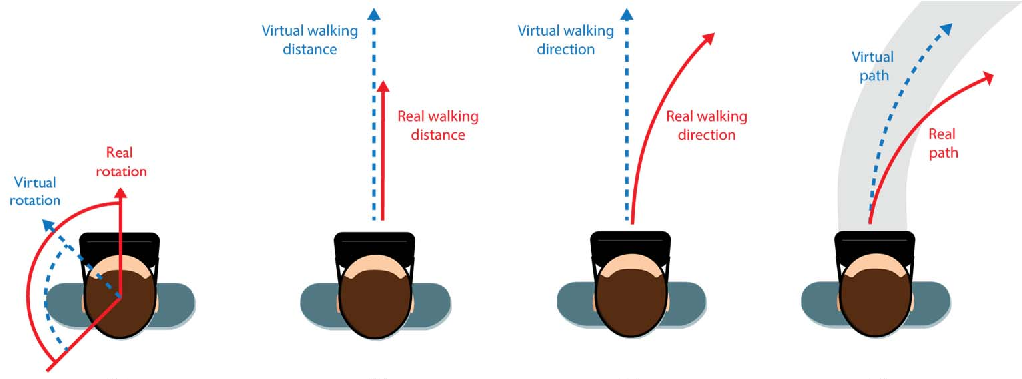
Redirected Walking
Manipulate the displayed movements (speed, angle, etc.) to help avoid obstacles and boundaries
Retain immersion within controlled usage
Nilsson, Niels Christian, et al. "15 years of research on redirected walking in immersive virtual environments." IEEE computer graphics and applications 38.2 (2018): 44-56.

Slide 13
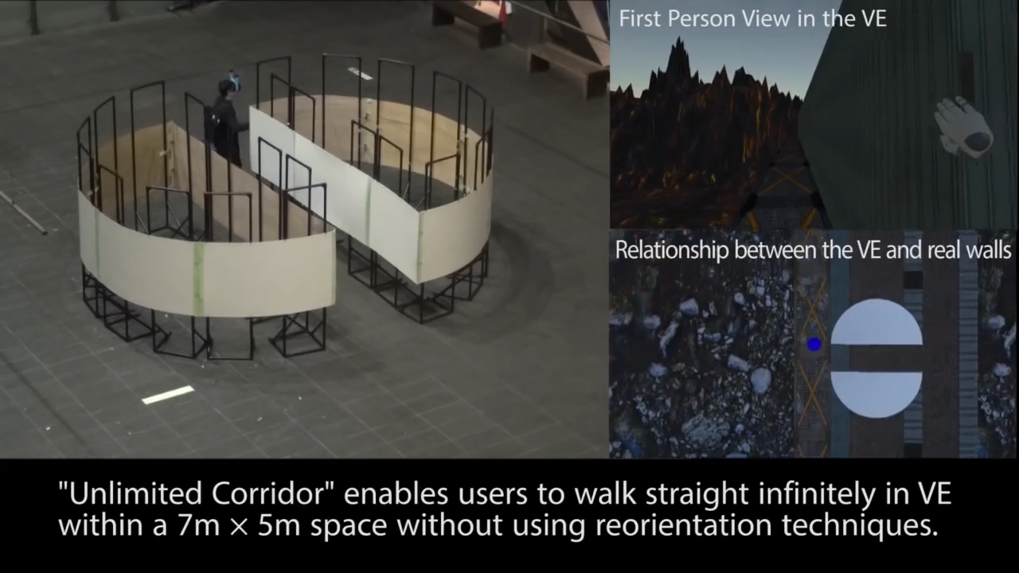
Redirected Walking
https://www.youtube.com/watch?v=THk92rev1VA

Slide 14
Research Problem
How to effectively guide users move between general POIs in dual worlds (i.e., unlimited to special structures)?

Slide 15
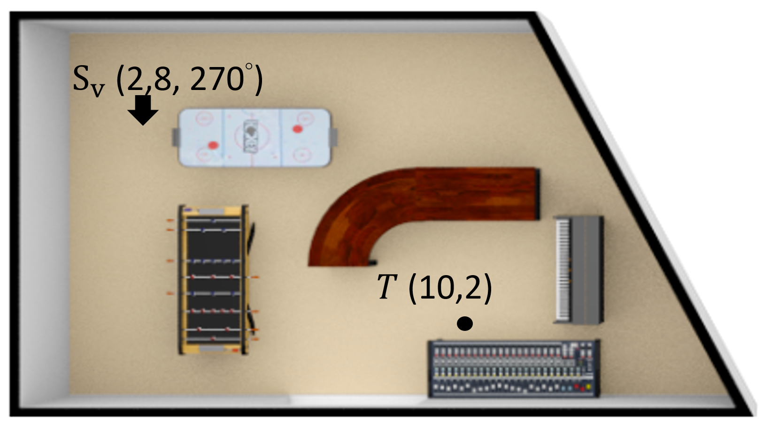
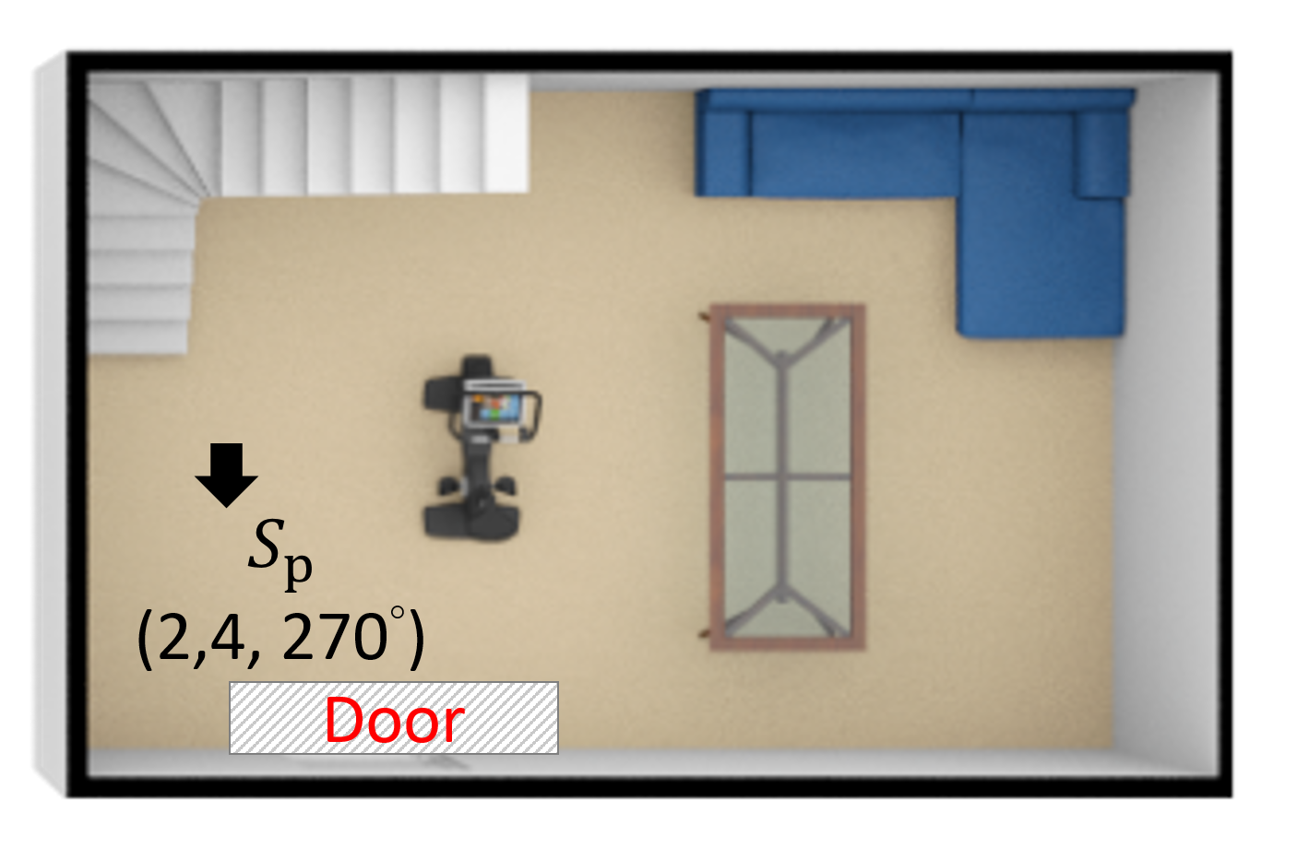
Research Problem
How to effectively guide users move between general POIs in dual worlds (i.e., unlimited to special structures)?
(a) virtual world.
(b) physical world.

Slide 16
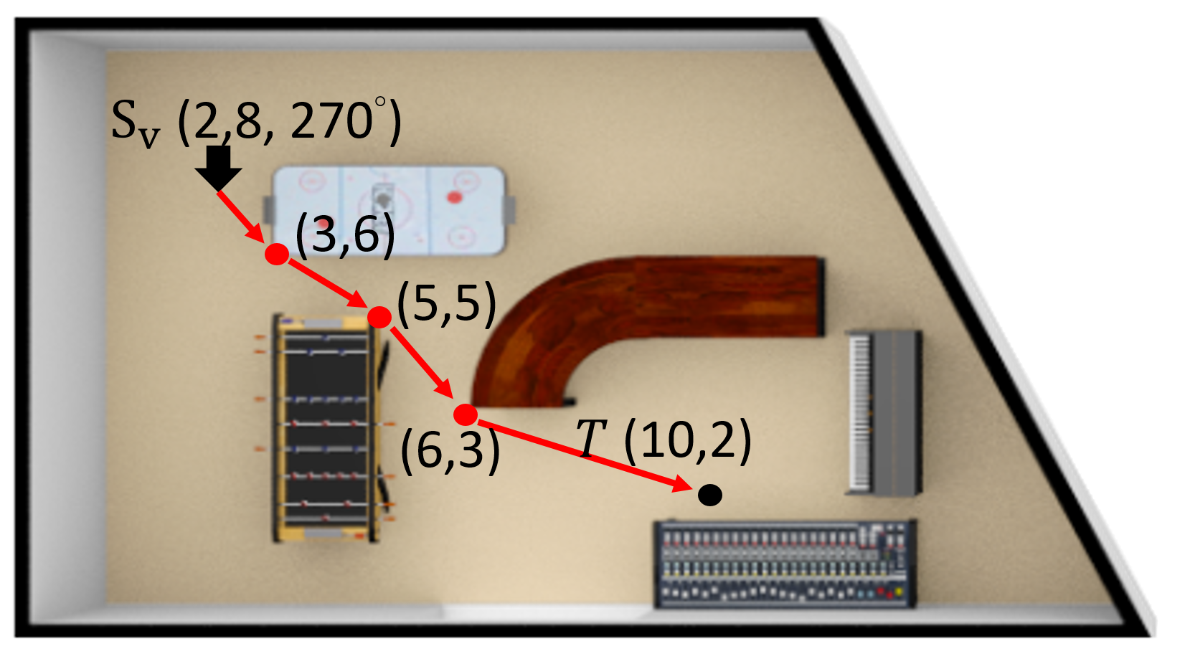
Research Problem
How to effectively guide users move between general POIs in dual worlds (i.e., unlimited to special structures)?
(a) virtual world.
(b) physical world.

Slide 17
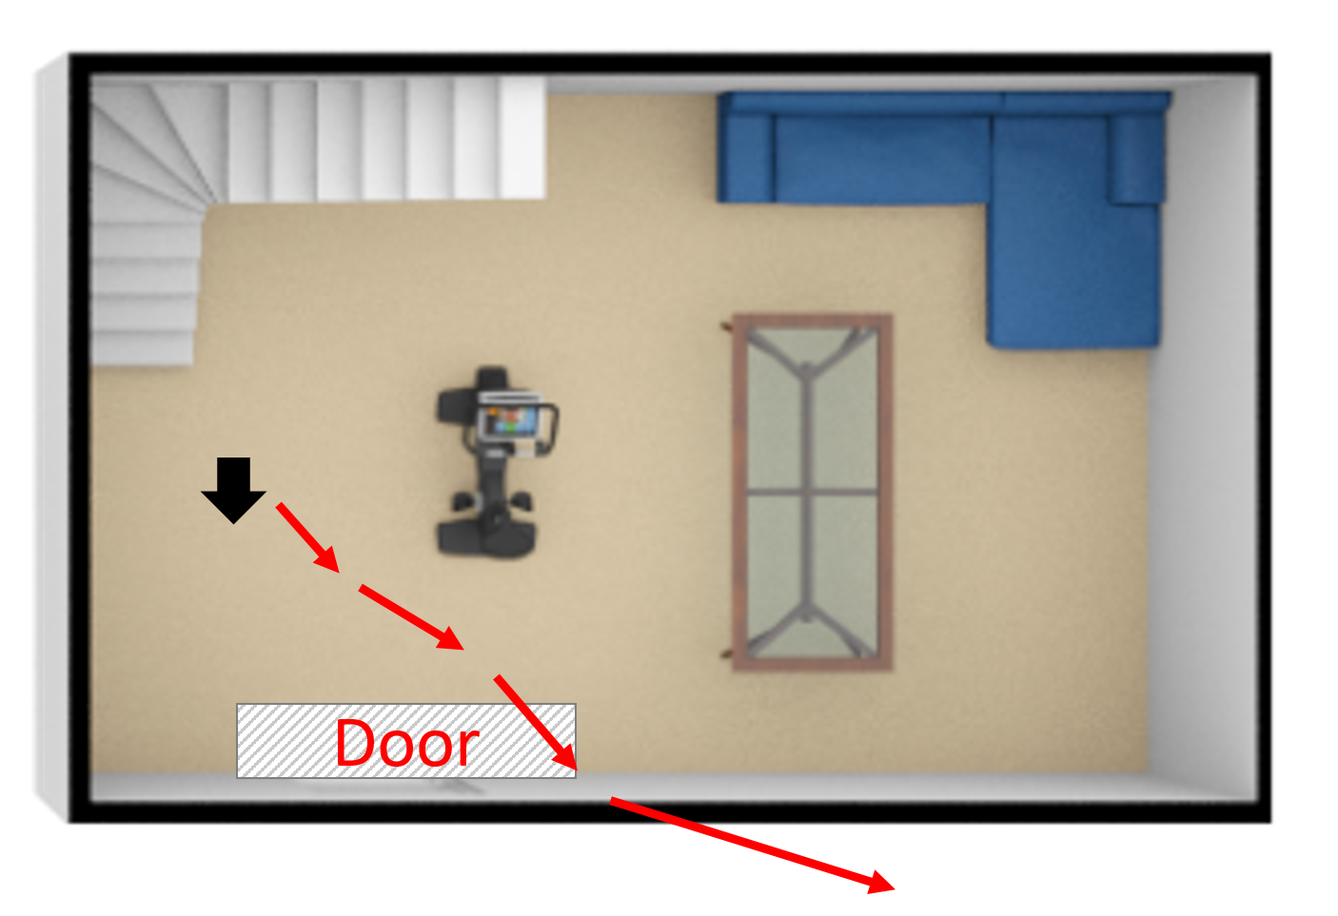
Research Problem
How to effectively guide users move between general POIs in dual worlds (i.e., unlimited to special structures)?
(a) virtual world.
(b) physical world.

Slide 18
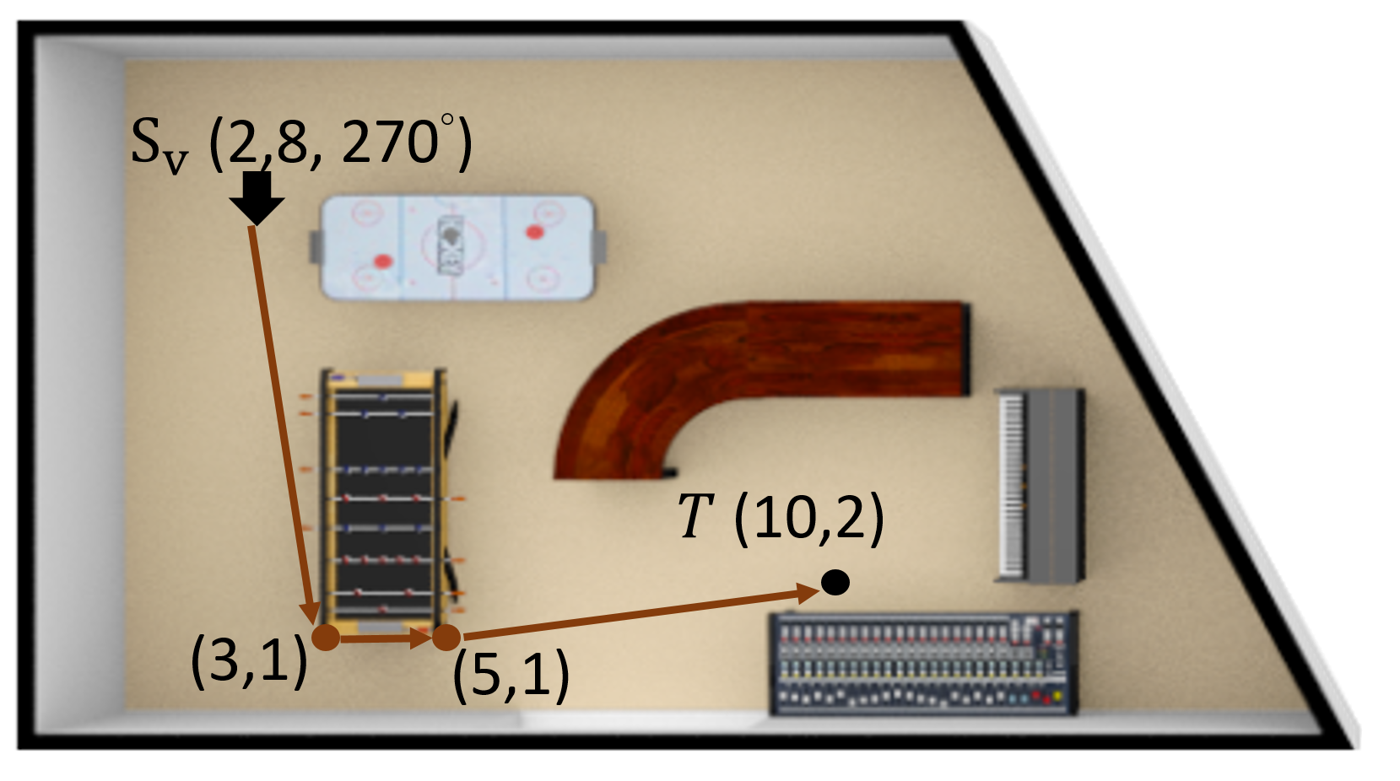
Research Problem
How to effectively guide users move between general POIs in dual worlds (i.e., unlimited to special structures)?
(a) virtual world.
(b) physical world.

Slide 19
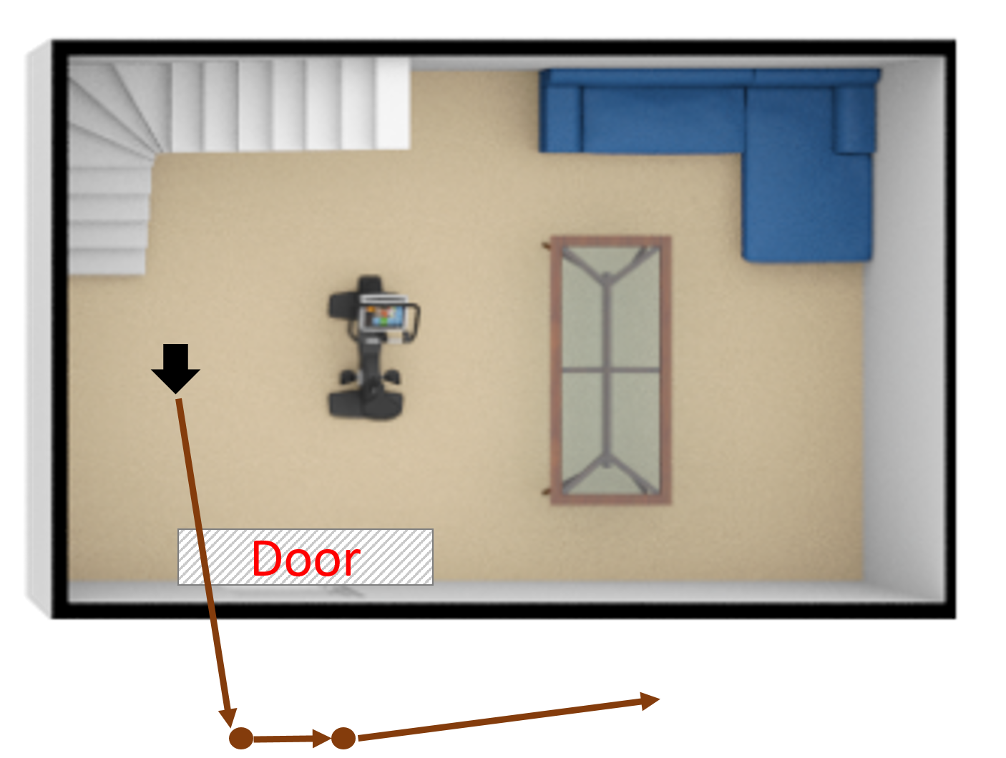
Research Problem
How to effectively guide users move between general POIs in dual worlds (i.e., unlimited to special structures)?
(a) virtual world.
(b) physical world.

Slide 20
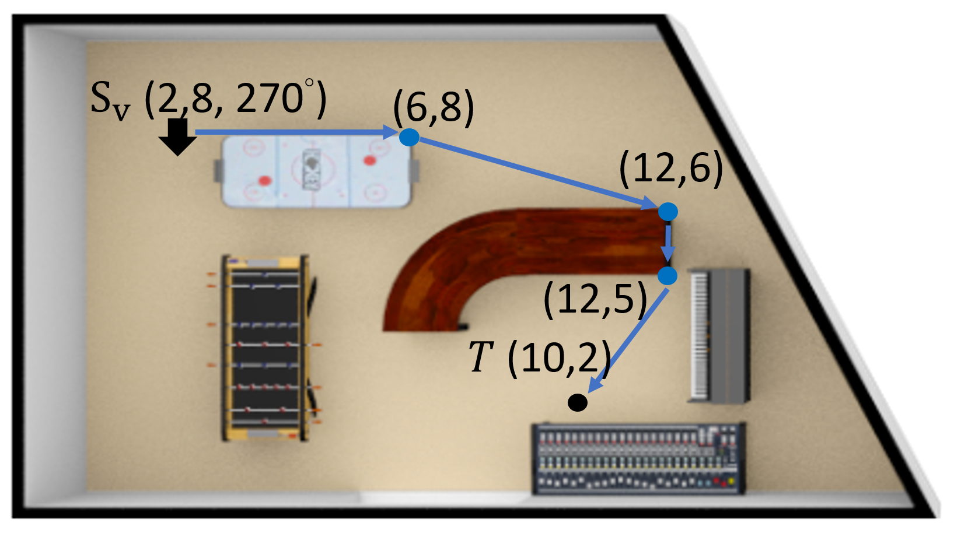
Research Problem
How to effectively guide users move between general POIs in dual worlds (i.e., unlimited to special structures)?
(a) virtual world.
(b) physical world.

Slide 21
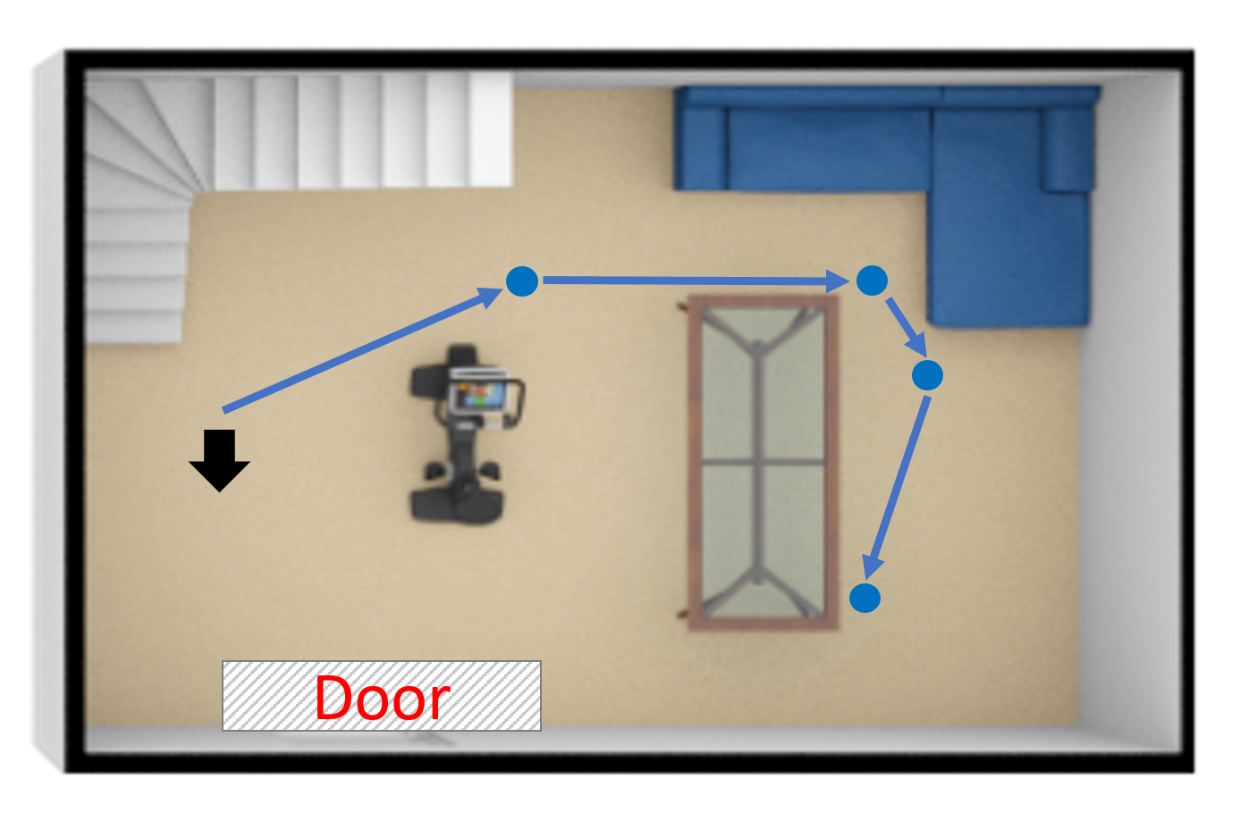
Research Problem
How to effectively guide users move between general POIs in dual worlds (i.e., unlimited to special structures)?
(a) virtual world.
(b) physical world.

Slide 22
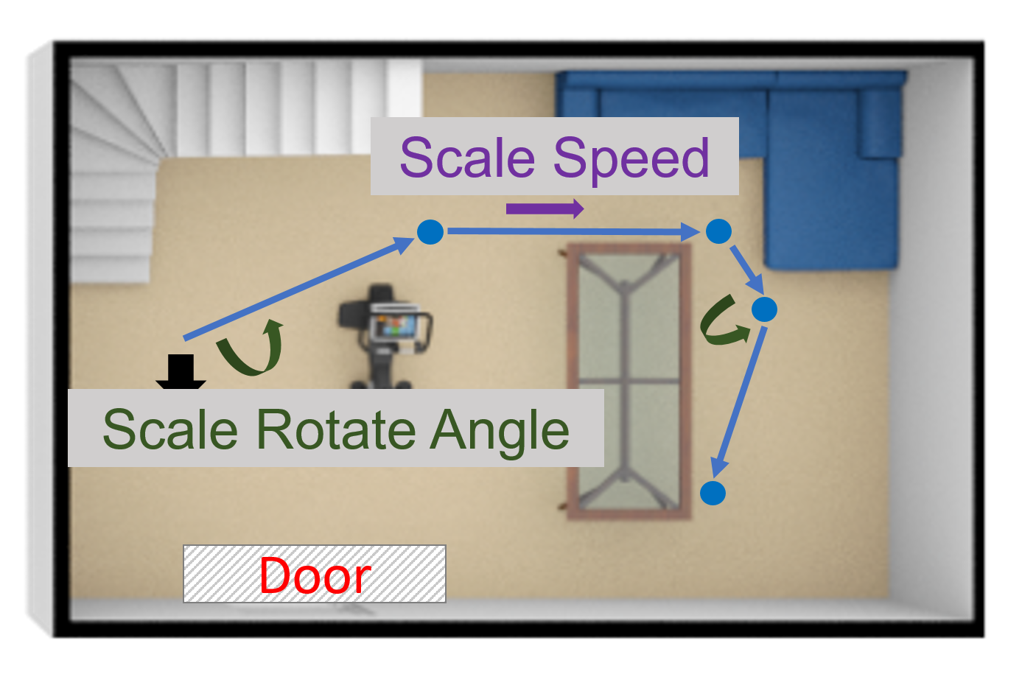
Research Problem
How to effectively guide users move between general POIs in dual worlds (i.e., unlimited to special structures)?
(a) virtual world.
(b) physical world.

Slide 23
DROP problem (high-level)
Given:
layouts of dual worlds & current user positions
a destination in virtual world
a cost metric on realizing RW operations
Find:
a path in virtual world (v-path)
its obstacle-free realization in physical world (p-path)
corresponding RW operations
Such that
length of v-path is minimized
total cost (incurred by RW operations) is constrained

Slide 24
Abstraction of obstacles
Visibility Graph (VG) in computational geometry
nodes: (1) corners of convex hulls of obstacles (2) POIs
edges between unobstructed nodes
preserves unobstructed shortest paths
ensures natural movements
(2,8)
(6,8)
4
2.2
6.3
(3,6)
(12,6)
3
2
(6,6)
6
1
(5,5)
3
(12,5)
7.1
(6,3)
5
4
4.1
3.6
2.2
(10,2)
(3,1)
2
(5,1)
5.1

Slide 25
Abstraction of Redirected Walking costs
We introduce the generic notion Minimum Immersion Loss (MIL) to work with any possible cost model
transform the problem into state-transition with costs
Definition: Minimum Immersion Loss (MIL)
MIL(st₁,st₂) represents the smallest RW cost for a VR user to move from a locomotion state st₁ to another neighboring locomotion state st₂ with a sequence of RW operations.

Slide 26
Solving DROP: Baselines
We prove DROP is NP-hard (reduction from 0-1 Knapsack)
Try to realize the shortest (top-k shortest) v-path in the physical world
Cannot ensure feasibility
Try to find the feasible dual-world path with lowest cost
Tend to find long zigzagging paths
Integrate dual worlds into a large state space, then exploit traditional algorithms for constrained shortest path (CSP)
Extremely low scalability due to large state space

Slide 27
Dual Entangled World Navigation (DEWN)
Computation on ONE graph/world is efficient
Computation on the integrated dual-world state space (i.e., two-world) is expensive
Q: can we do the bulk of computation only in the virtual world?
Observation
The objective (length of v-path) in the dual-world DROP problem depends only on the virtual world
Main Idea of DEWN
Accelerating processing of the dual-world DROP problem as much as possible by one-world computations

Slide 28
Leveraging 1-world computation
A natural trade-off between computation efforts in Step I and II.
Step I: Reference Path Generation
Generate a decent feasible solution (reference path) heuristically
very quickly using mainly 1-world computation
reference path
Step II: Pruning/Path Navigation
Based on the reference path, design novel pruning strategies to avoid examining redundant states in dual-world state space

Slide 29
Step I: Reference Path Generation
We introduce the notion of MIL Range to compress the information of MIL (depending on dual worlds) into one world.
Original problem instance
precomputed lower & upper bounds of MIL
In a final optimal path, this cost is between
3 and 4.
(a) Cost-Optimistic Simplified (COS) instance
(b) Cost-Pessimistic Simplified (CPS) instance

Slide 30
Step I: Reference Path Generation
Guess: the optimal multipliers for simplified problems are quality estimates for the original problem.
Fact: feasibility is guaranteed by pessimistic estimation!
Lagrange Relaxation
(MIL goes to objective)
= 6.3+4x2
Exploit Informed Search (e.g. A*) on dual-world state space with these multipliers. (only dual-world step for reference path)
Solve the optimal multiplier for COS (leading to a best feasible solution)
an iterative ONE-world algorithm
Solve the optimal multiplier for CPS
(leading to a best feasible solution)
an iterative ONE-world algorithm
(c) COS-Lagrange Relaxation
(multiplier = 1)
(d) CPS-Lagrange Relaxation
(multiplier = 2)

Slide 31

Leveraging 1-world computation
Step I: Reference Path Generation
Generate a decent feasible solution (reference path) heuristically
very quickly using mainly 1-world computation
reference path
Step II: Pruning/Path Navigation
Based on the reference path, design novel pruning strategies to avoid examining redundant states in dual-world state space

Slide 32
Step II: Pruning and Path Navigation
Based on the reference path, design pruning strategies
destination state
reference path
start state
estimate shortest path distances
e.g., Dijkstra’s algorithm
one-world, one metric: FAST!
estimate minimum RW cost
e.g., Dijkstra’s algorithm
one-world, one metric: FAST!
Discard if the total distance is over the length of reference path
Suboptimal Loco-State Pruning
Discard if the total cost is over the cost constraint
Infeasible Loco-State Pruning
current state
and other strategies…
KEY: use one-world computation in pruning criteria

Slide 33
Leveraging 1-world computation
Step I: Reference Path Generation
Generate a decent feasible solution (reference path) heuristically
very quickly using mainly 1-world computation
Usually a good enough (e.g., 95%) solution.
Extremely efficient and practical for large instances
reference path
Step II: Pruning/Path Navigation
Based on the reference path, design novel pruning strategies to avoid examining redundant states in dual-world state space
Significantly more efficient than directly examining the whole state space!
We are left with a significantly smaller state space.
Dynamic Programming with Rounding and Scaling on the remaining states ensures the solution quality (FPTAS).

Slide 34
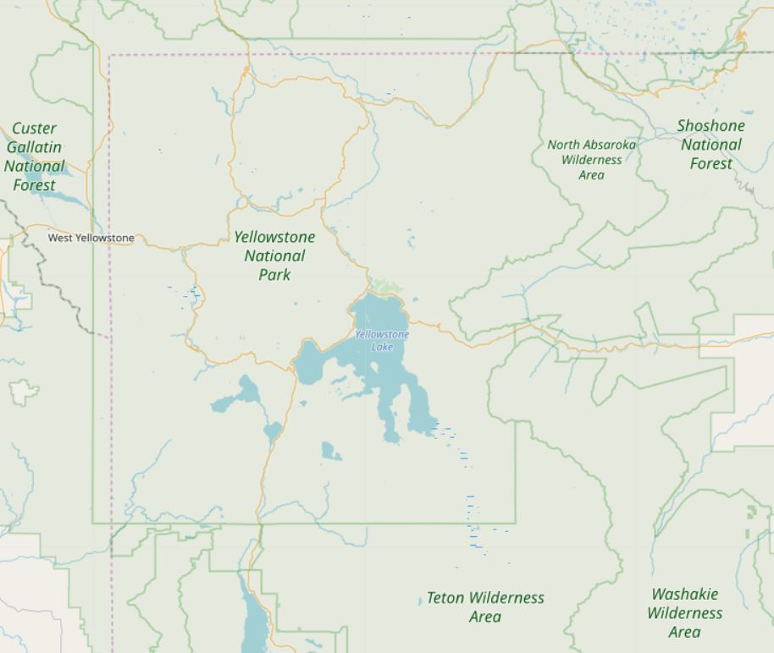
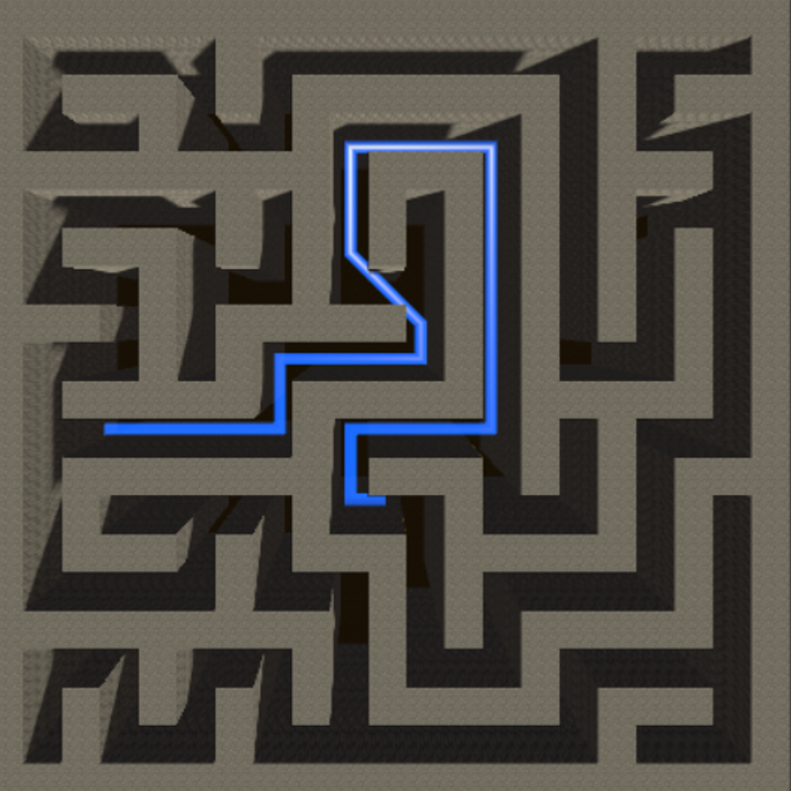
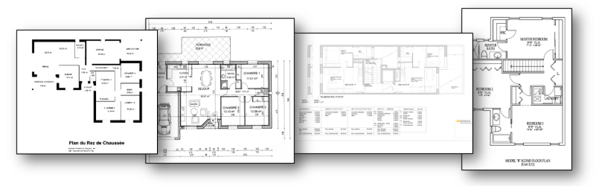
Experiment Setup
Virtual world: we collect data for virtual traveling and gaming scenarios
OpenStreetMap (OSM)
Urban street layouts (Boston, Seattle, Taipei…)
Natural sites (e.g. Yellow Stone)
Maze Game Maps
Physical world: real indoor layouts
https://www.openstreetmap.org
https://github.com/boppreh/maze
http://dag.cvc.uab.es/resources/floorplans/

Slide 35
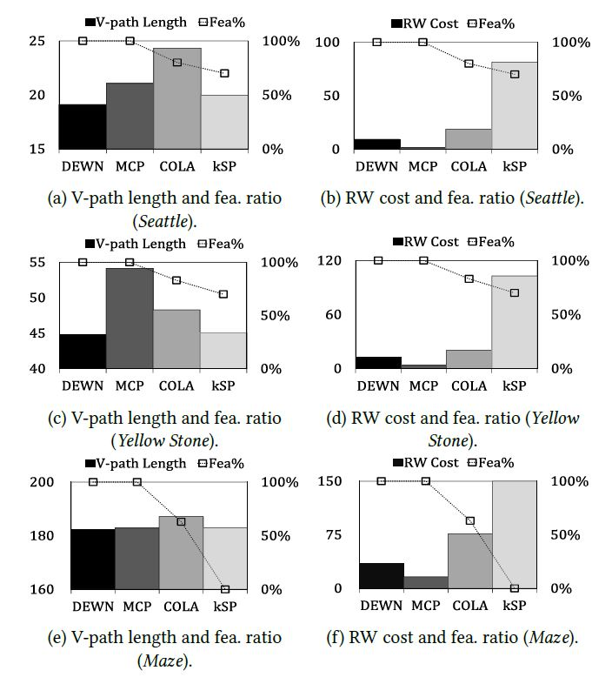
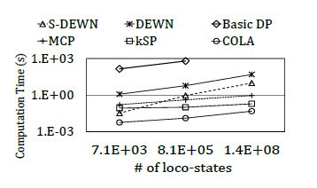
Comparisons on different VR scenarios
DEWN consistently
finds shorter RW paths
incurs low RW costs
achieves high feasibility
across all datasets.
DEWN is more scalable than naive Dynamic Programming
S-DEWN (finding the reference path) is very scalable

Slide 36
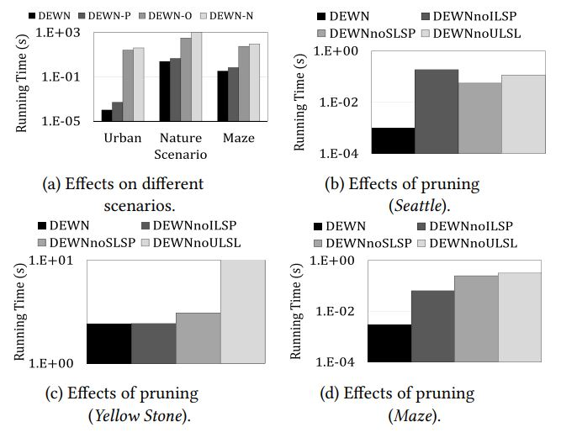
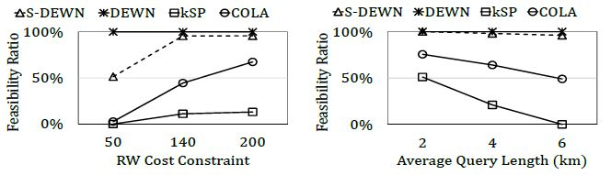
Sensitivity tests
All proposed pruning and ordering strategies significantly lower the running time of DEWN
DEWN is more robust to difficult input instances, e.g.
low cost constraint
long query length

Slide 37
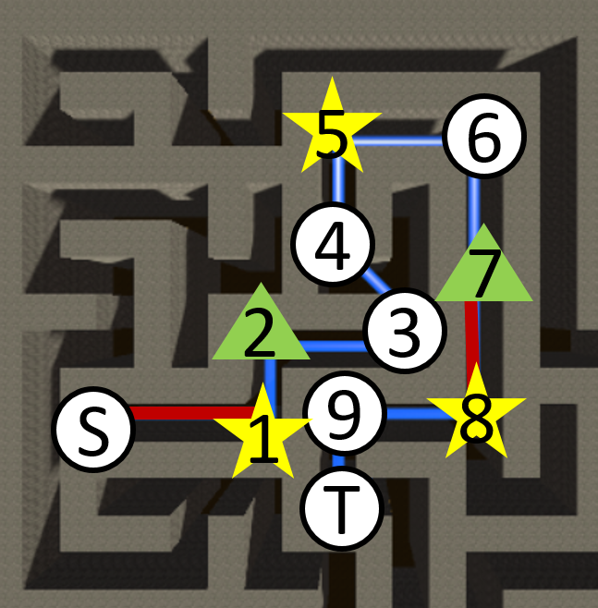
User Study
We conduct a user study to understand users’ behaviors in real VR system with Redirected Walking
3D Pac-man game with real walking
built in hTC VIVE via Unity 2017.3.1 and SteamVR 1.2.2
Users provide feedback on immersion and simulator sickness
The presence questionnaire
Simulator Sickness Questionnaire (SSQ)
https://marketinginvolvement.files.wordpress.com/2013/12/pq-presence-questionnaire.pdf
https://www.tandfonline.com/doi/abs/10.1207/s15327108ijap0303_3
(a) a v-path in a maze map
(b) a corresponding p-path

Slide 38
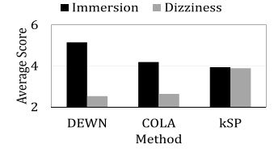

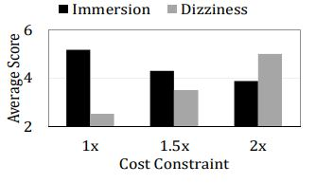
User Study
We conduct a user study to understand users’ behaviors in real VR system with Redirected Walking
3D Pac-man game with real walking
built in hTC VIVE via Unity 2017.3.1 and SteamVR 1.2.2
Users provide feedback on immersion and simulator sickness
The presence questionnaire
Simulator Sickness Questionnaire (SSQ)
https://marketinginvolvement.files.wordpress.com/2013/12/pq-presence-questionnaire.pdf
https://www.tandfonline.com/doi/abs/10.1207/s15327108ijap0303_3
Users experience greater immersion and less motion sickness with DEWN
(a) a v-path in a maze map
(b) a corresponding p-path

Slide 39
Conclusion
We identified and addressed the problem of moving in dual worlds (virtual + physical) from a data-centric computational view
We formulated the DROP problem to find a virtual shortest path and its RW realization with a constraint of immersion using Redirected Walking
We proposed an effective and efficient algorithm
Has theoretical guarantee (FPTAS)
Combines optimization techniques with
problem-specific heuristics (Dual-world nature)

Slide 40
Thank You ☺
Shao-Heng Ko
arsenefrog@iis.sinica.edu.tw

